Slide 1
A Machine Learning Approach to Predicting National Champions in Division 1 Women’s Basketball
D’Anna Cvetnich
Thursday, April 27, 2023

Slide 2
AGENDA
Introduction​
Web-Scraping
Machine Learning
Bracket Creation
Conclusion

Slide 3

Introduction
“March Madness” with D-1 Men’s and Women’s College Basketball Teams
Single elimination tournament
Women’s tournament does not get the same coverage or attention as Men’s tournament.
Women's side consistently produces talented players, facing the same level of competition and pressure as the men's teams.
This project aims to use data and analytics to shed light on the talent and abilities of women's teams, predict the outcomes of the women's national championship tournament, and bring more attention to the women's side of the sport.
https://espnpressroom.com/us/files/2023/03/WMM_Logo.png

Slide 4
TIMELINE
Jan. 15-28
Jan. 29-Feb. 10
Feb. 12-Mar. 24
Mar. 25-April 12
April 13-17
Exploration of Possible Topics
Diving into Previous Research in Area of Chosen Topic
Collection and Cleaning of Data from Internet
Creation of Machine Learning Model
Using Created Model to Predict Tournament Season

Slide 5
Web-Scraping
Collection and Cleaning of Data

Slide 6

Data Source
Researched several statistic databases
NCAA Stats (stats.ncaa.org)
ESPN
Sports-Reference.com
Sports-Reference.com
Sport statistic database
Trusted Source
Consistent layout and data
Large amount of data
Most data in one place
https://techgraphs.fangraphs.com/wp-content/uploads/sites/7/2015/09/SR.png

Slide 7


Data Source Structure
Game Title
2022 Tournament
Game Winner
2021 Tournament
Game 1
Line Score
2019 Tournament
Game 2
Season Index
Four Factors
$$⋮$$
$$⋮$$
Team 1 Basic Box Score
Table of all March Madness Tournaments from 1982-2023
2012 Tournament
Game 63
Team 1 Advanced Box Score
2011 Tournament
Individual Games in Tournament
Team 2 Basic Box Score
2010 Tournament
Team 2 Advanced Box Score
All Games in that Tournament Season
Statistics for Individual Game
getTourneyYearLinks
getTourneyGameLinks
getGameInfoStats
dataSave

Slide 8
Process
getTourneyYearLinks
getTourneyGameLinks
getGameInfoStats
dataSave
getTourneyYearLinks(url)
Takes specific start URL for the web database sports-reference.com
Returns arrays of tournament years and links to respective tournament pages
getTourneyGameLinks(url)
Takes URL to specific tournament year page
Returns array of links to all games in that tournament season
getGameInfoStats(url)
Takes given URL to game in tournament
Returns dictionary with game title, winner, line score, four factors, and basic/advanced box scores for each team
Each table formatted as a pandas dataframe
dataSave(df, folderLocation, fileName, fileType)
df is a pandas dataframe, folderLocation is the folder where it is to be saved, fileName is the name of the file saved, fileType is the file type, including the `.`
Given dataframe has been converted to csv format and saved in the given folder with the given name as the given file type
Notes:
Go thru what ea does, how it was implemented, and the fact that all data couldn’t be gathered in one go due to time out errors (did ~3-5 at a time)

Slide 9

Data Cleaning
Collected total of 693 games worth of data
11 tournaments, 63 games per tournament
Ensure all data points were in correct format
Handled games with missing values
Number (Int, Float)
Bool
Removed non-statistical data
Player names
Removed excess players
5 players with most time played
Overall averages and totals for team
Removed unnecessary data categories
Player names
Minutes played
Categories that were not universally shared by games
https://cdn.technologyadvice.com/wp-content/uploads/2022/06/Data-Cleaning-scaled.jpeg

Slide 10
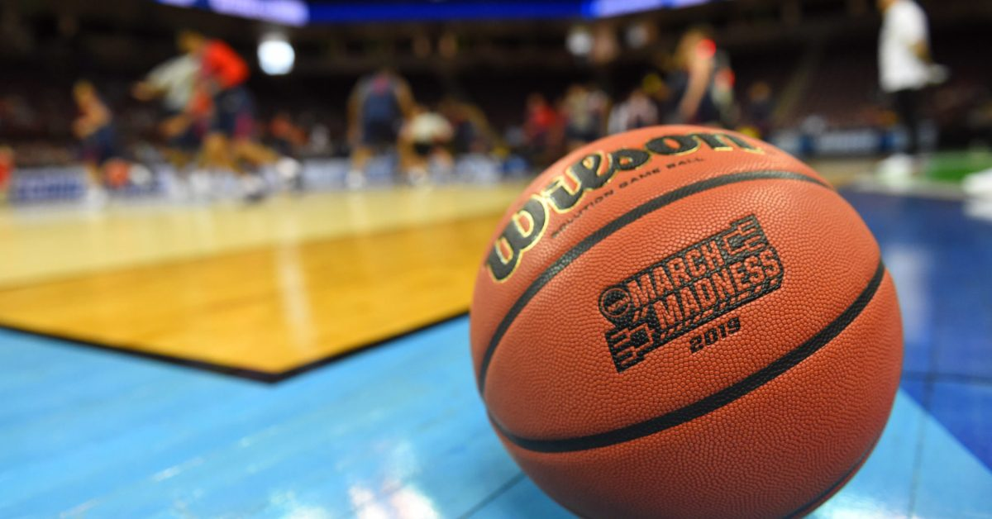
Feature Manipulation
Left with most relevant statistics
Some statistics directly gave game winner
Field Goals (FG), 2 Point Field Goals (2P), 3 Point Field Goals (3P)
Created new statistics: FG%, 2P%, 3P%
Other New Categories:
AST/TOV (Assists per Turn Over)
FT/FGA (Free-throws per Attempted Field Goal)
‘MAX’ categories
Collected all game data into a single row
Opposing team statistics marked with ‘_OPP’
https://www.saturdaydownsouth.com/wp-content/uploads/2020/03/USATSI_12388296-scaled.jpg?w=1200&h=628&crop=1

Slide 11
Machine Learning
Creation of Model

Slide 12

Choosing a Model
Models Explored:
Ridge Regression
Linear Regression
Logistic Regression
Support Vector Machine (SVM)
K-Nearest neighbors classifier
Decision tree classifier
Random forest classifier
Gaussian Naive Bayes
Multi-Layer Perceptron (MLP) Classification
Neural Network
Most models did not yield promising predictions
scores hovered around ~53-57%
Neural Network showed most promise
3-fold Cross Validation Scores were highest
[0.64779874, 0.60252366, 0.58044164]
Research showed several other projects found that Artificial Neural Networks (ANNs) to be most accurate in this type of data prediction
Rory P. Bunker and Fadi Thabtah
A machine learning framework for sport result prediction
McCabe and Trevathan
Artificial intelligence in sports prediction

Slide 13
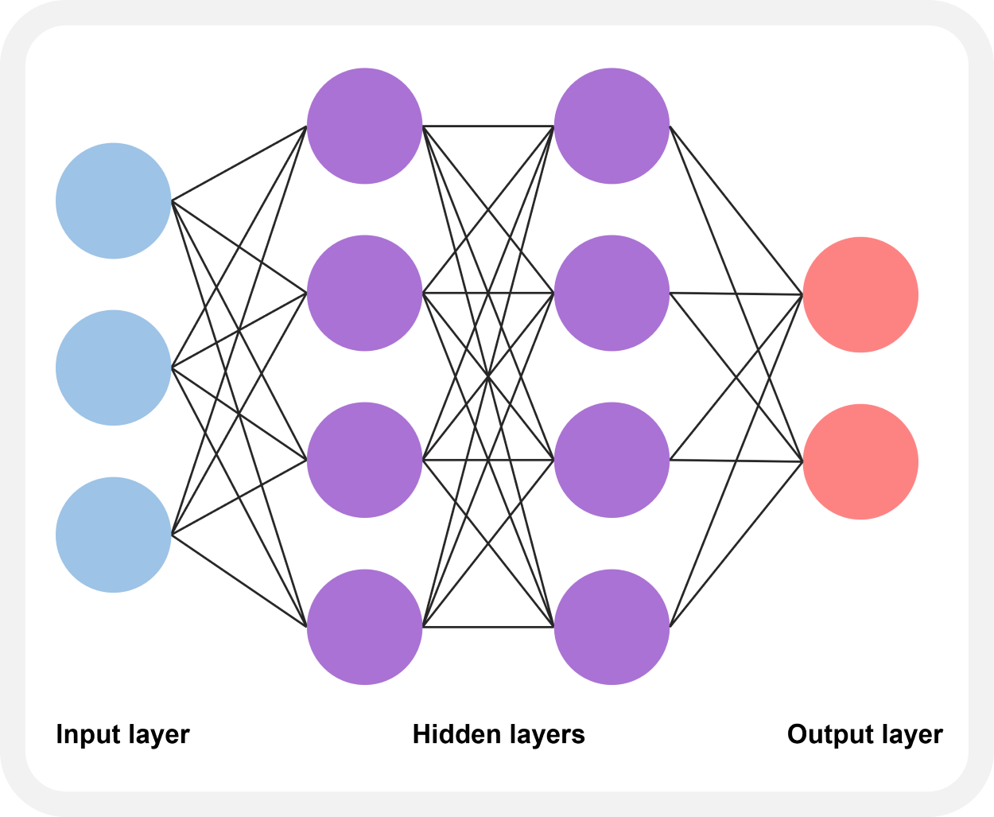
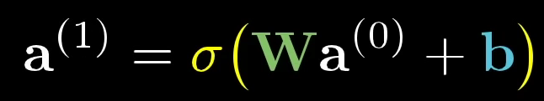
About Neural Networks
Loosely modeled on human brain
Consists of many simple processing nodes
Thousands to Millions of nodes
Deeply interconnected
Input values feed into ‘Hidden Layers’
Each node in hidden layer has associated weight
Weights are tuned during learning
Additional ‘biases’ in some models
Hidden Layers = ‘Black Box’
‘Black Box’
https://swb.skku.edu/_res/hatl/img/neural2.png

Slide 14
Bracket Creation
Predicting All Games in a Tournament

Slide 15

Bracket Creation
Predictions made per round to simulate actual play
Data from winners extracted
Once all rounds predicted, results inserted into HTML bracket
Scored with ESPN Tournament Challenge Scoring Rules
Bracket of ‘real’ results also created for comparison
https://www.ncaa.com/_flysystem/public-s3/2022-02/22_WFF_Logo_0.png

Slide 16
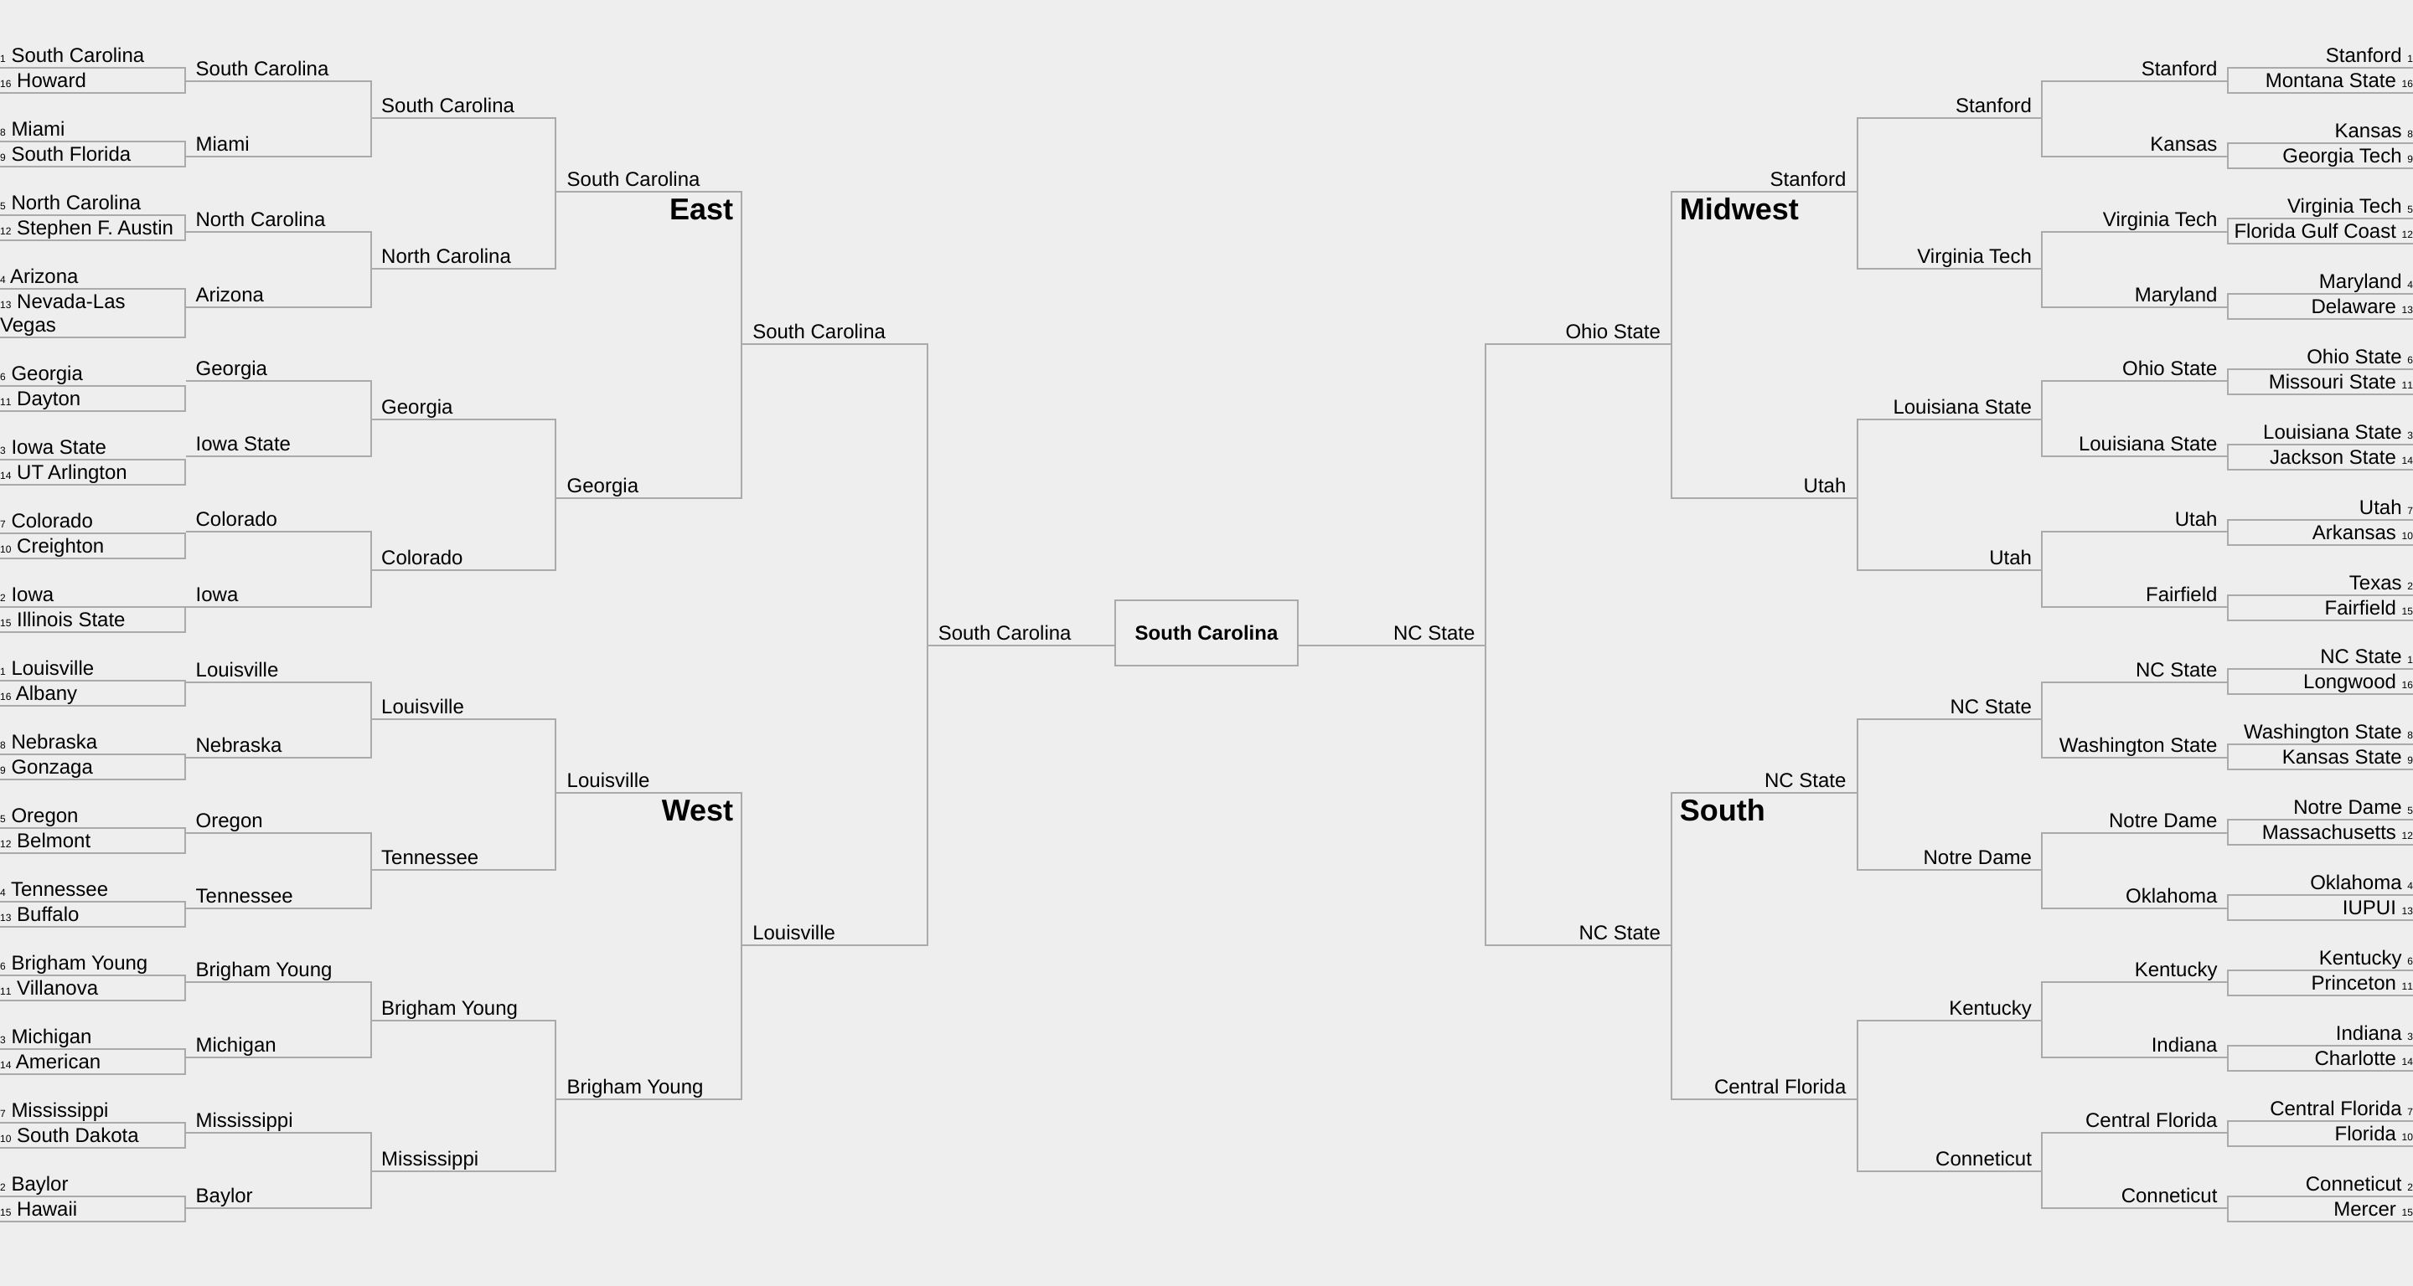

Slide 17
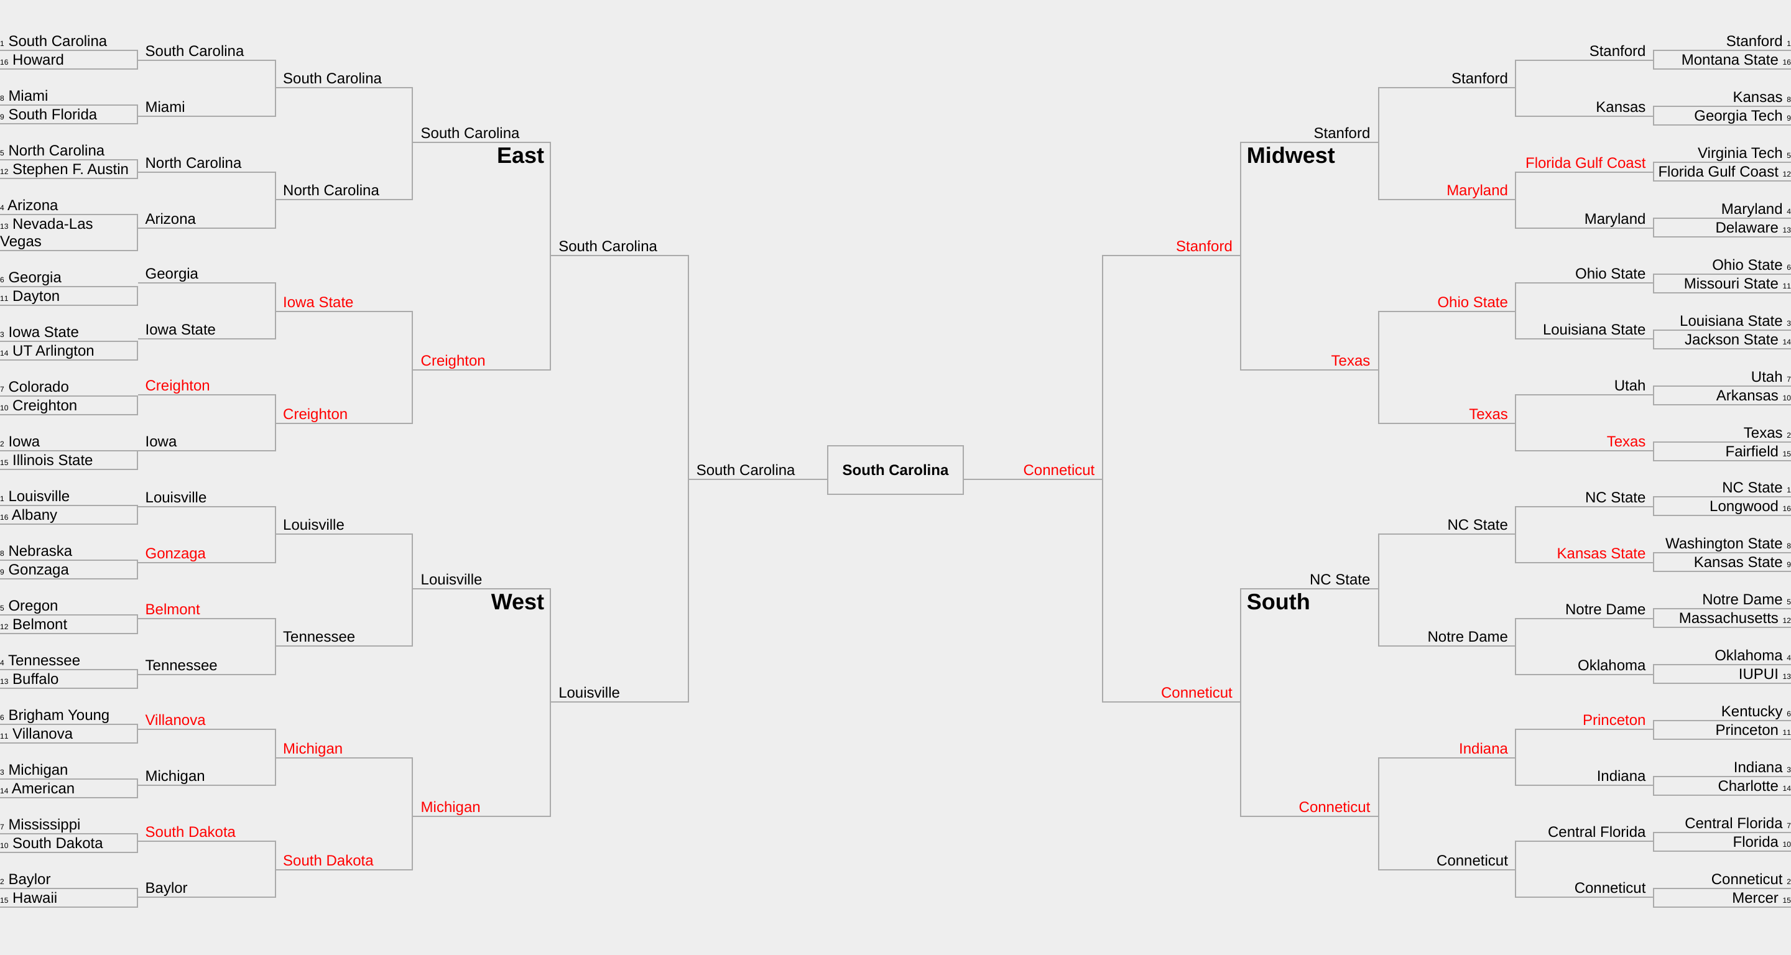

Slide 18

Bracket Scoring
Round | Teams | Games | Points (each) | Points Possible
First Round | 64 | 32 | 10 | 320
Second Round | 32 | 16 | 20 | 320
Sweet Sixteen | 16 | 8 | 40 | 320
Elite Eight | 8 | 4 | 80 | 320
Final Four | 4 | 2 | 160 | 320
National Championship | 2 | 1 | 320 | 320
Totals | -- | 63 | -- | 1920
https://a.espncdn.com/combiner/i?img=/games/s/tcwomen/20/tcw-primary-transparent.png&transparent=true

Slide 19
Scoring of Predicted Bracket for 2022 Season
Round | Games | Points (each) | Points Predicted | Points Possible
First Round | 32 | 10 | 230 | 320
Second Round | 16 | 20 | 160 | 320
Sweet Sixteen | 8 | 40 | 160 | 320
Elite Eight | 4 | 80 | 160 | 320
Final Four | 2 | 160 | 160 | 320
National Championship | 1 | 320 | 320 | 320
Totals | 63 | -- | 1190 | 1920

Slide 20
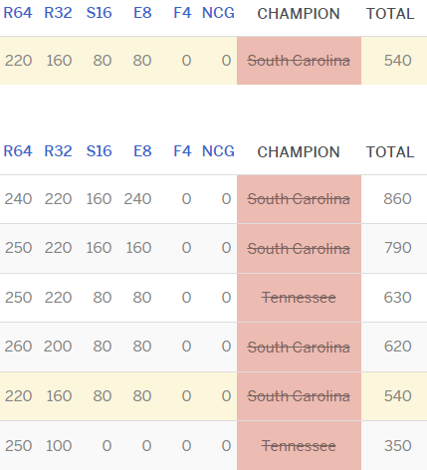
Comparing human and machine learning predictions
2022 Tournament Season Machine Learning Prediction
Correctly Predicted National Champion
39/63 Games Correctly Predicted
62% Accuracy
Total Score: 1190
2023 Tournament Season Human Prediction
Incorrectly Predicted National Champion
33/63 Games Correctly Predicted
52.4% Accuracy
Total Score: 540

Slide 21
SUMMARY
The model has an accuracy of approximately 61% overall.
More accurate models exist, but have much larger data sets used to train model.
Data set was limited to the past eleven tournament seasons
693 total games
Other models found were trained on datasets 50x larger
Able to predict 2022 champion
Results better than human predictions on following season

Slide 22
Questions?
Thank you for coming!

